Slide 1



Psychology
For Nursing
Relaxation
Assist. Lec. Doaa M. Bachi

Slide 2

Relaxation
Relaxation is a process that decreases the effects of stress on your mind and body.
The state of being free from tension and anxiety

Slide 3
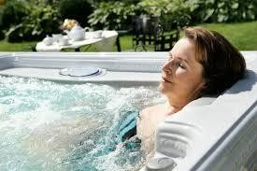
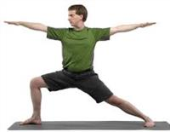
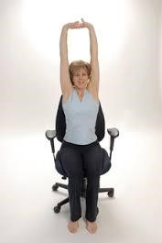
Relaxation techniques
A relaxation technique (also known as relaxation training) is any method, process, procedure, or activity that helps a person to relax; to attain a state of increased calmness; or otherwise reduce levels of pain, anxiety, stress or anger.

Slide 4
The Benefits Of Relaxation Techniques
Slowing heart rate
Lowering blood pressure
Slowing your breathing rate
Improving digestion
Maintaining normal blood sugar levels
Reducing activity of stress hormones
Reducing muscle tension and chronic pain
Improving concentration and mood
Improving sleep quality
Lowering fatigue
Reducing anger and frustration
Boosting confidence to handle problems
Increasing blood flow to major muscles

Slide 5
Relaxation Techniques
The majority of techniques can be classified in to either physical, mental or therapeutic techniques
Relaxation techniques
Physical
Mental
Therapeutic

Slide 6
Tips for Doing Relaxation
Set aside 30 – 45 minutes
NOT after a meal
Quiet, distraction-free environment
Dim lights
Warm temperature
Loose clothing
Lie down or sit in a comfortable chair

Slide 7
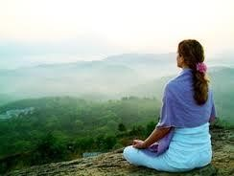

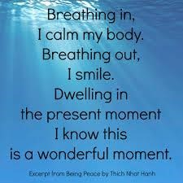

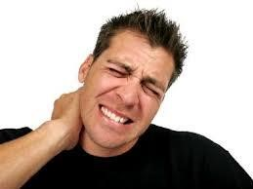
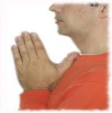
METHODES OF RELAXATION TECHNIUQUES

Slide 8
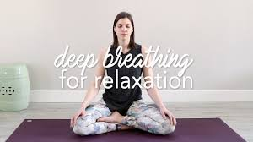
1.Deep Breathing Techniques
Techniques are one of the easiest ways to reduce stress
Sit with your legs uncrossed, good posture, and place your hands on your thighs. Close your eyes. Inhale deeply through your nose into your abdomen for a long count of five seconds (your chest should move only a little). Hold for a long count of two seconds, then breathe out slowly through your mouth for a long count of five. Repeat for 10 to 15 cycles.

Slide 9
2.Progressive Muscle Relaxation
Is a relaxation technique that requires an individual to focus on flexing and holding a certain set of muscles and then slowly relaxing those same muscles
Loosen any tight clothing, sit or lie comfortably, and close your eyes. Tense different muscles of your body as much as you can for at least a count of 10. Then, slowly release the tension and allow the muscle to relax. Let that feeling of relaxation flow through your body. Start at your feet and move up.

Slide 10
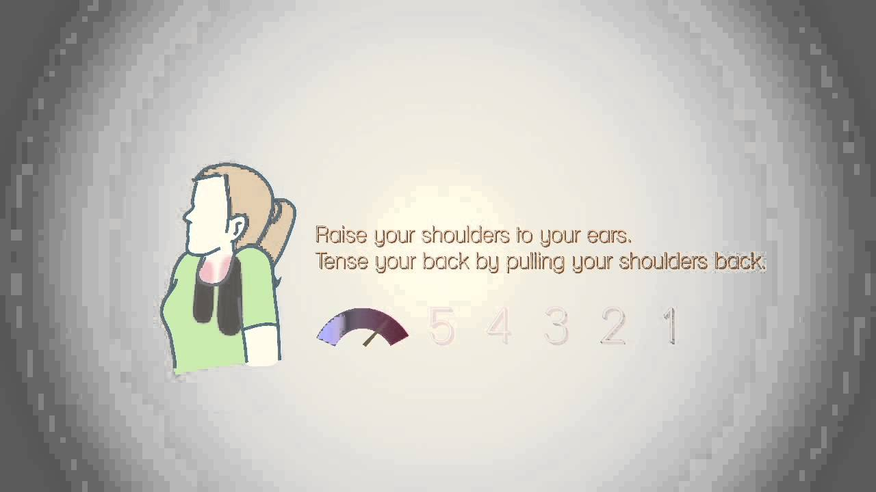

Slide 11
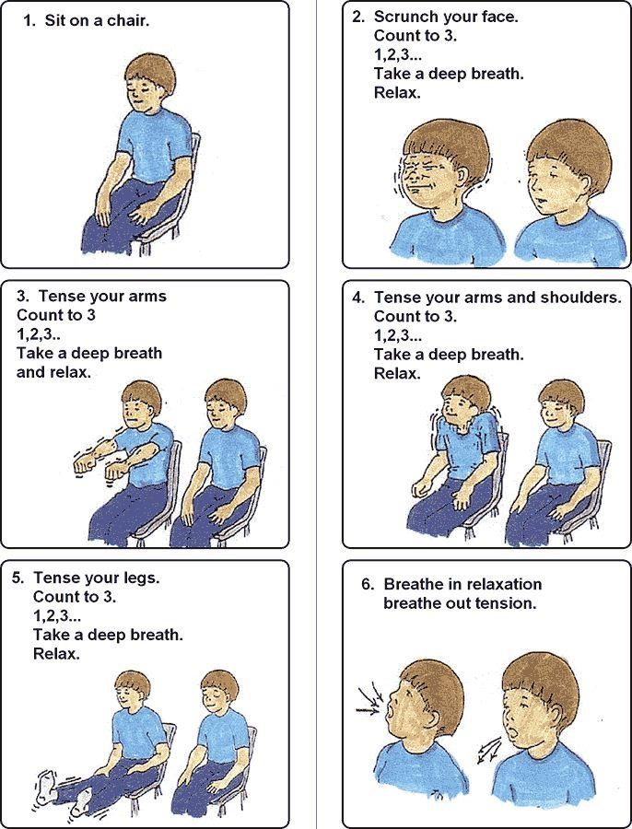

Slide 12
3.Meditation
Is a practice where an individual uses a technique – such as mindfulness, or focusing the mind on a particular object, thought, or activity – to train attention and awareness, and achieve a mentally clear and emotionally calm and stable state

Slide 13
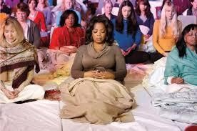
Sit comfortably in a quiet spot. Close your eyes if you like. Breathe in through your nose. As you exhale, say the word ‘one’ silently to yourself. You might like to focus on the sound you make exhaling (like the sanskrit word ‘om’). Or, if your eyes are open, focus on an object, exploring its colours and textures. Spend at least 10 minutes meditating, but stay focused

Slide 14
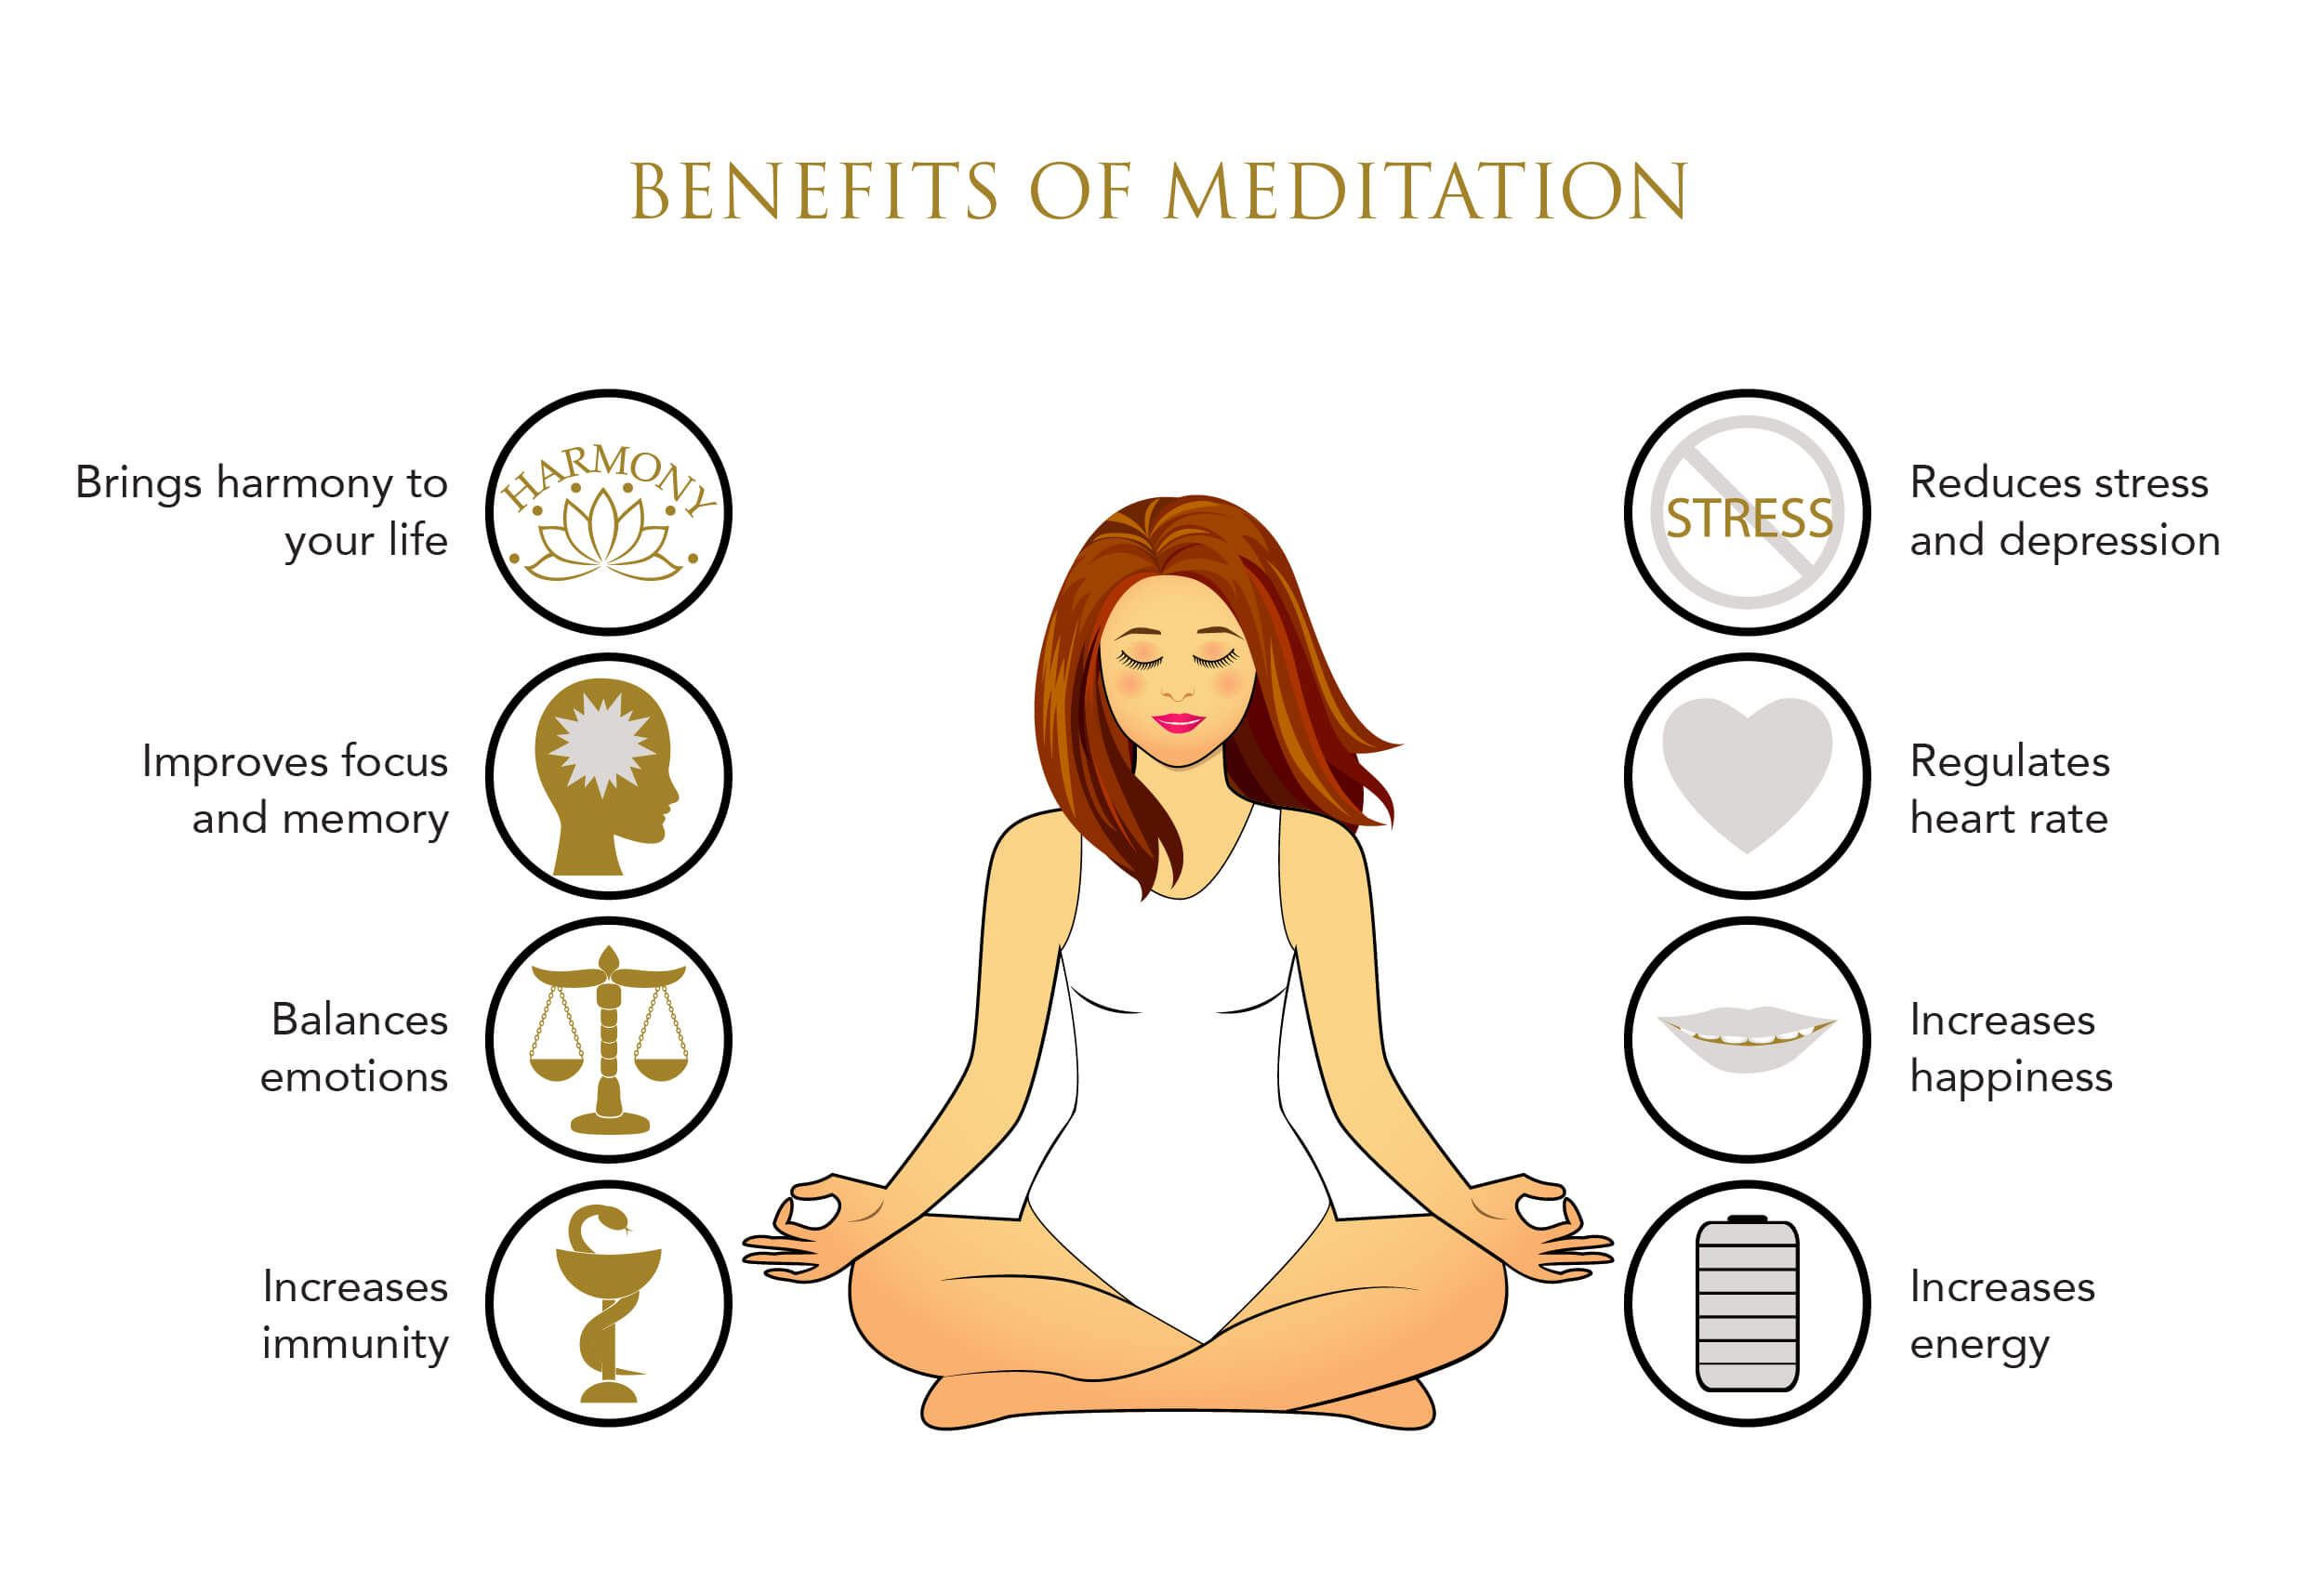

Slide 15
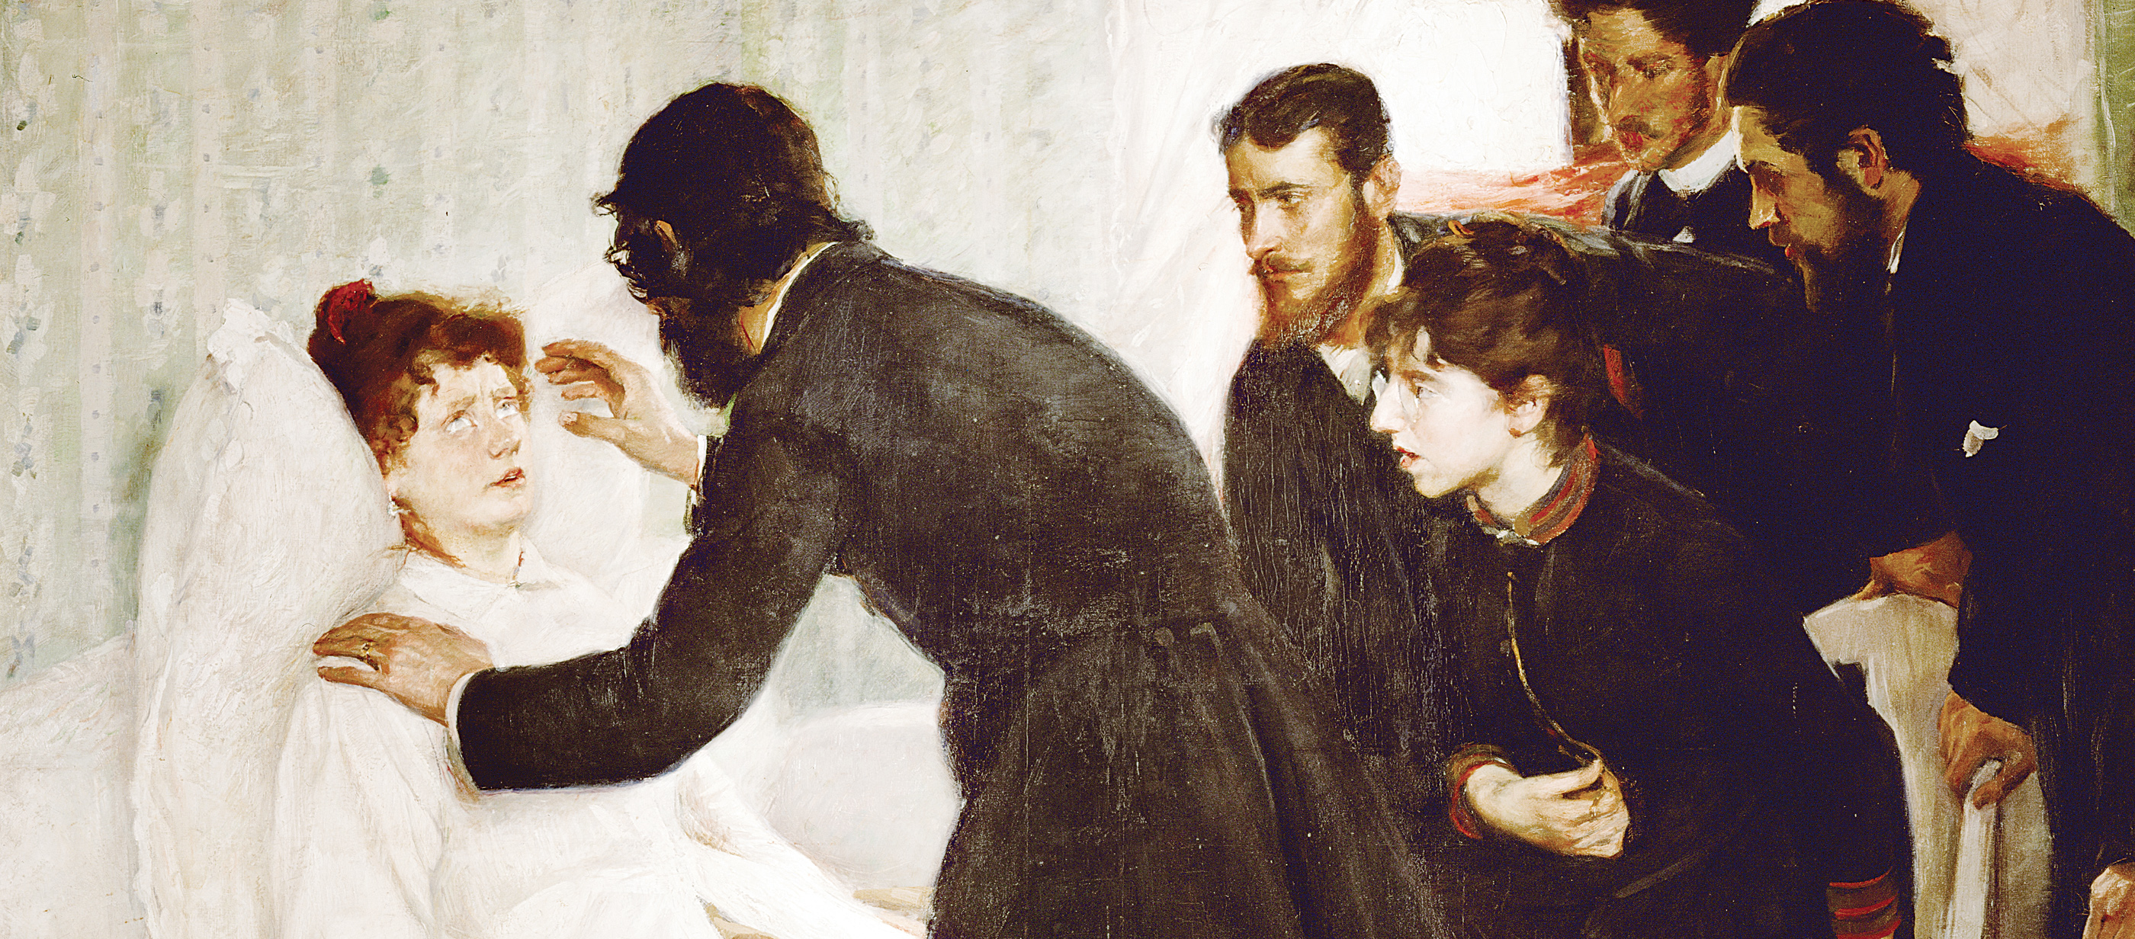
4. Hypnosis
Hypnosis is a human condition involving focused attention, reduced peripheral awareness, and an enhanced capacity to respond to suggestion

Slide 16
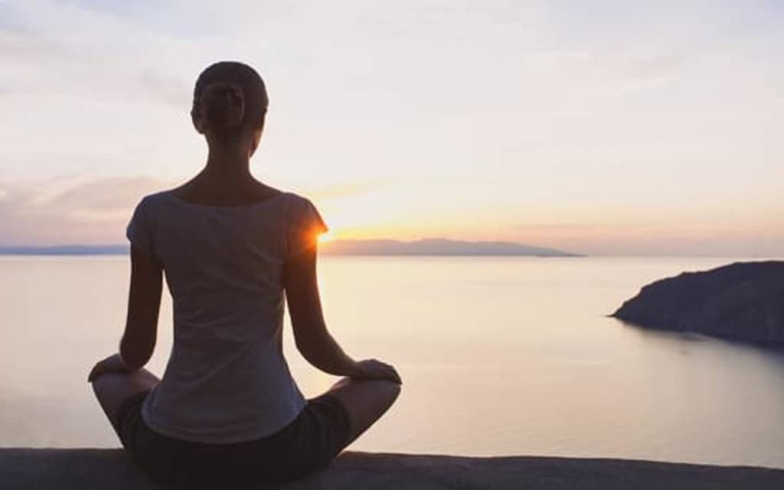
5.Creative Visualization
This is a technique where you imagine a scene, place or situation you regard as safe, restful, and happy. Sit comfortably in a quiet place. Breathe gently through your nose, eyes closed. Picture in your mind the place you like – a forest, the beach, a field. Try and smell the aromas, taste the air, hear the sounds. Feel your body relax. Continue for at least 10 minutes.

Slide 17

6.Mandala Circles
This is a drawing technique to calm the mind. Bring a pencil/s and paper to a quiet place. Draw a large circle. Now, be prepared to keep drawing for at least 10 minutes. Start filling the circle with whatever you like – spirals, patterns, running-writing – but don’t let the pencil leave the paper unless you’re changing colors.

Slide 18
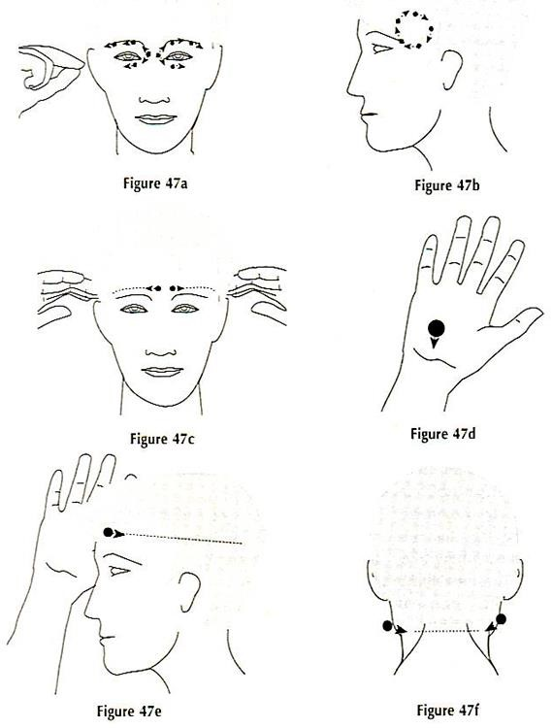
7. Massage
. Massage therapy is another effective way to provide relief from chronic pain. Most massage therapists will provide massage to the affected area as well as the whole body with the goal to relieve muscle pain as well as improve circulation

Slide 19
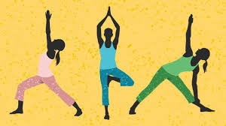
8. YOGA
Yoga is an ancient system of breathing practice, physical exercise, and postures and meditation intended to integrate the practitioner’s body, mind, and spirit.
Yoga uses combination of physical postures (asanas), breathing techniques (pranayamas) and meditation to promote relaxation and enhance the flow of vital energy called prana. •
It is essential for a nurse to have baseline information and awareness of yoga which is purely Indian in origin.

Slide 20
Un-Healthy Coping
Consuming too much caffeine
Smoking
Drinking in excess
Compulsive spending
Emotional eating
Using drugs
Defensiveness
Blame others/avoid responsibility
Act out- passive/aggressive
Spend a lot of time on watch TV. Or Social Media
NO

Slide 21
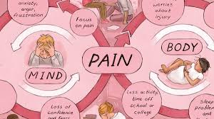
Pain
Pain: is a general term that describes any kind of unpleasant or uncomfortable sensation in the body

Slide 22
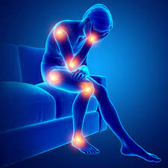


Slide 23
Acute pain this starts suddenly and only lasts for a short period (ie, minutes, hours, a couple of days, occasionally a month or two) (A broken bone).
Chronic pain is pain that has persisted for longer than six months and is experienced most days.(Arthritis, Back pain, Cancer, Headache)
Breakthrough pain is a sudden, short, sharp increase in pain that occurs in people who are already taking medications to relieve chronic pain caused by conditions such as (arthritis, cancer, coughing)

Slide 24
Bone pain this is a tenderness, aching or discomfort in one or more bones that is present during both exercise and rest.
Nerve pain is caused by nerve damage or inflammation. (An injury to the brain, a nerve, or the spinal cord, Cancer, Limb amputation)
Phantom pain is pain that feels like it is coming from a body part that is no longer there. It is common in people who have had a limb amputated, but is different from phantom limb sensation, which is usually painless
Soft tissue pain This is pain or discomfort that results from damage or inflammation of the muscles, tissues, or ligaments.(Back or neck pain, Bursitis)
Referred pain This is pain that feels like it is coming from one particular location, but is the result of an injury or inflammation in another structure or organ.

Slide 25
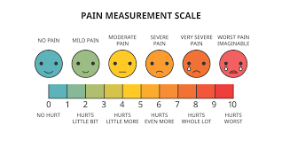

Slide 26
Pain Management
Pain management, pain medicine, pain control or algiatry: is a branch of medicine employing an interdisciplinary approach for easing the suffering and improving the quality of life of those living with chronic pain.

Slide 27
Pain management strategies
1. Pain-relieving medicines (analgesic)
2. Physical therapies (such as heat or cold packs, massage, hydrotherapy and exercise)
3. Psychological therapies (such as cognitive behavioural therapy, relaxation techniques like meditation and yoga)
4. Mind and body techniques (such as acupuncture)
5. Occupational therapy

Slide 28
